Slide 1
CAR Champion Calibration Meeting CAR Review
Team “C”
Tovia Bat-Leah (CAR 13391183 Finding & CAR 133911731 Observation)
Jim Oates (Unable to present due to Audit commitment)
Jeff Lietz (CAR 133911586 Finding & CAR 133912110 Exemplary)

Slide 2
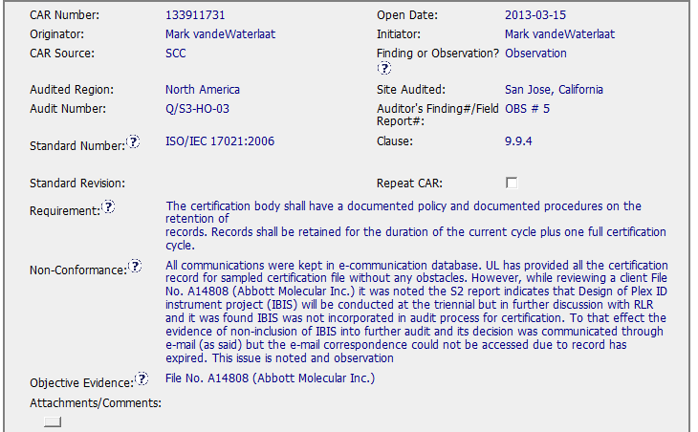
No sample size was noted

Slide 3
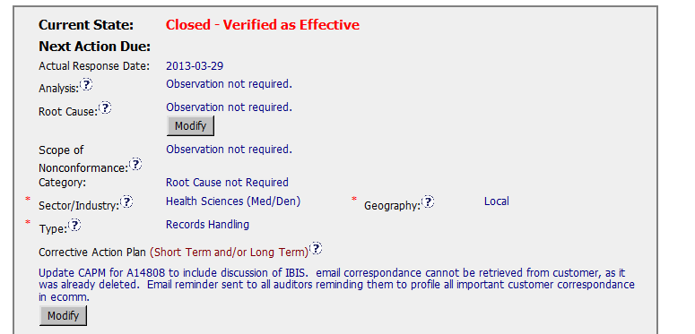
Good: Correct category, sector.

Slide 4
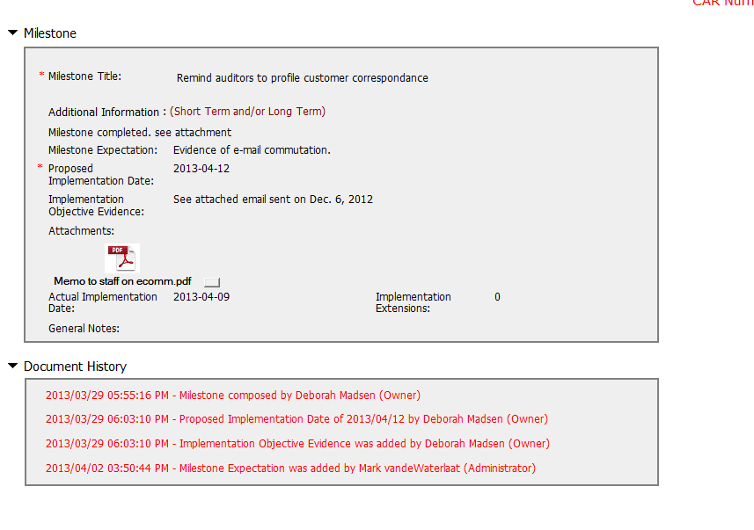
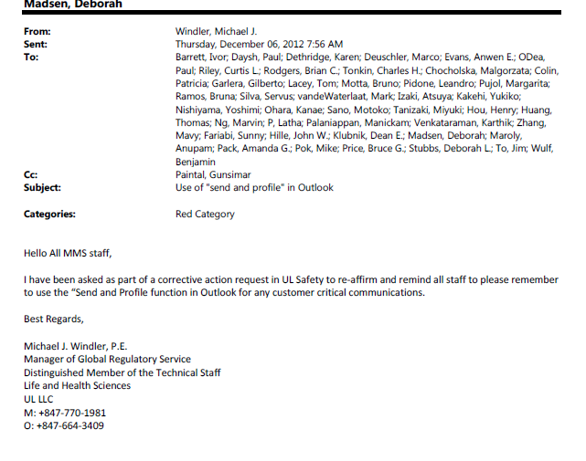
Email ? How effective is that?.
When accepting emails for training, each recipient must respond affirming that they have read and understood the email content.
Good: Objective evidence supports closure of milestone.

Slide 5
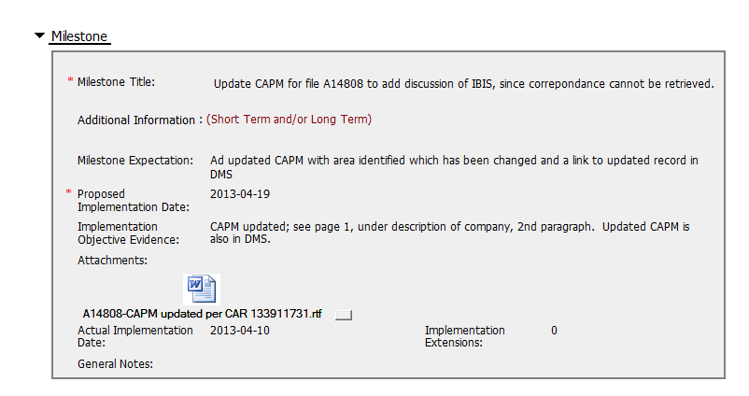
Good: update of available documents in place of missing email

Slide 6

OB CAR not verified on close

